Slide 1
Least Squares Approximation
using QR Decomposition
MA1508E Group Project
Notes:
Hello pr

Slide 2
01.
Introduction

Slide 3
What is QR factorization?
QR factorization is a decomposition of matrix A into a product of QR with Q is an orthogonal matrix and R is an upper triangular matrix
The algorithm is used to solve linear least square problems, find eigenvalues,...

Slide 4
Least square problems
Standard approach to find least square solution: A^{T}Ax=A^{T}b
For our presentation, we are interested in a matrix A_{mxn} such that m>=n and columns of A are linearly independent
Q is an orthogonal matrix → Q^{T}Q = I
→ We have an equation to find least square solution: Rx=Q^{T}b
Notes:
The standard approach to find least square solution is use the equation given in the lecture note. For our presentation, we are interested in a matrix A size m n such that m bigger or equal to n and columns of A are linearly independent.Since Q is an orthogonal matrix, product of transpose Q and Q is an identity matrix. We have an equation to find least square solution: Rx=Q^{T}b.

Slide 5
Three methods to factorize a matrix into QR form
Gram Schmidt process
Householder reflections
Given rotations
Notes:
There are three methods to factorize a matrix into QR form. Gram Schmidt process, householder reflections and given rotations

Slide 6
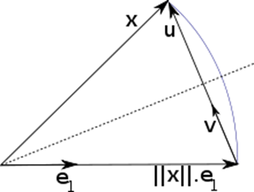
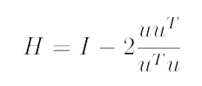
Householder reflections
This is the fastest method to factorize in general
Introduce zero under each leading entry in a column using a linear transformation. The transformation describes a reflection about a plane or hyperplane containing the origin
We introduce zero by changing a vector x into a vector of the same length which is collinear with e1(a standard unit vector)
→ u = x+sign(x1)*|x|*e1
The transformation is an orthogonal matrix
Notes:
Due to time constraint, we only focus on householder reflection as it is the fastest method in general. The method introduces zero under each leading entry in a column using a linear transformation. The transformation describes a reflection about a plane or hyperplane containing the origin. From the picture here, We introduce zero by changing a vector x into a vector of the same length which is collinear with e1(a standard unit vector)
Therefore, u equals to x plus product of signx1 normx e1 where x1 is the first element of vector x .. Then we use the transformation which is an orthogonal matrix H and H is calculated using the equation in the slide

Slide 7
Householder reflections
Applying for A_{mxn} matrix
+) Step 1:
x is the vector from the first column. Then we can find H1
Calculate H1*A we have R1 with first column in the form [a 0 0… 0]
+) Step 2:
x is the vector from the second column of R1 except the first entry of x is 0. Then we can find H2
Calculate H2*A we have R2 with first column in the form [a 0 0… 0] and second column [b c 0 … 0]
+) We repeat until we find triangular matrix R
→ Q^{T}=Hn*…*H2*H1

Slide 8
02.
Small Example
Notes:
So, to show you how the method of Householder Reflections work to decompose a matrix,

Slide 9
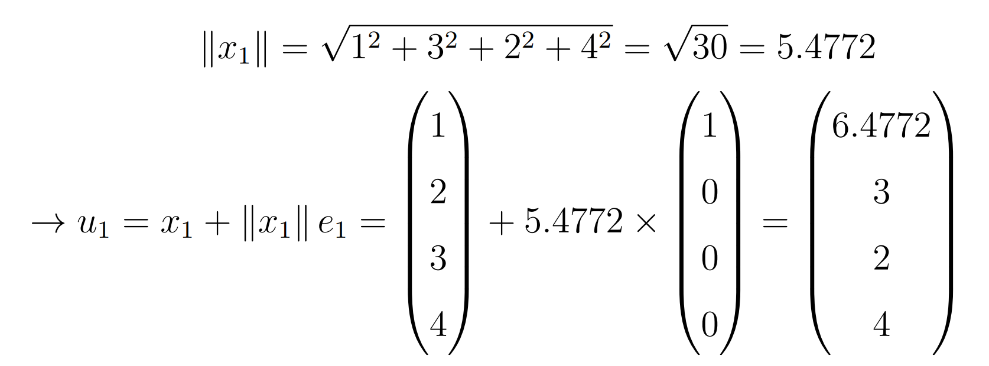
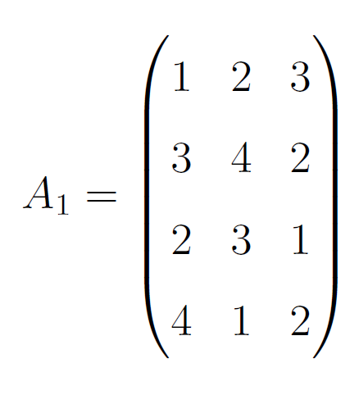
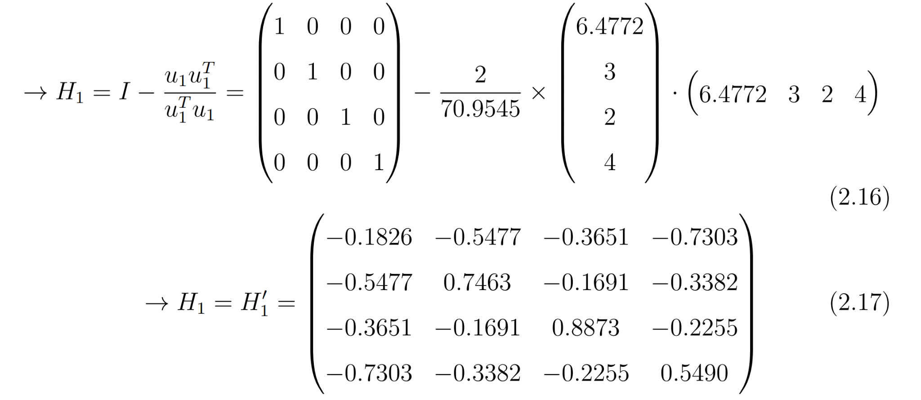
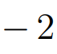
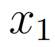
H1
Notes:
We start with the small matrix A as seen here. We take the first column vector of A, (1 3 2 4). We calculate mod x1, and use that find u1, according to the formula u1 = x1 + modx * identity vector
From there we calculate the first H matrix using the formula identity matrix - u1.u1T/u1T.u1. note that the bottom term is a the row dot the column, and ends up being a single entry.

Slide 10
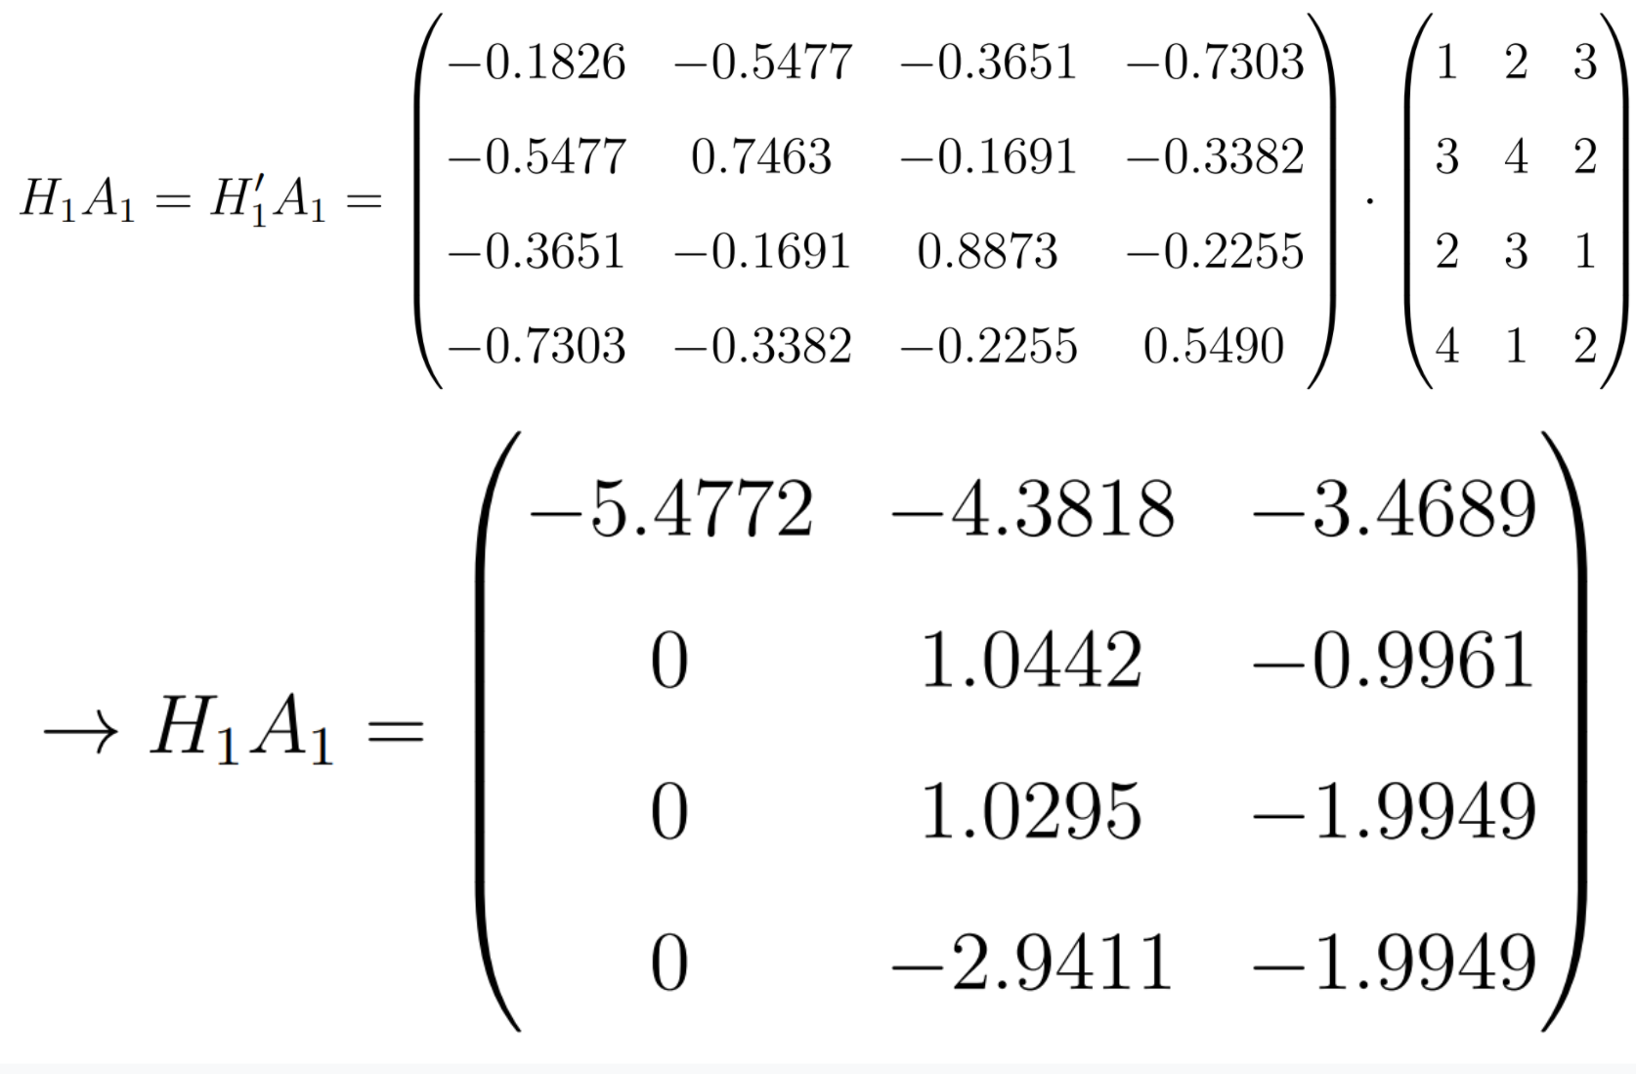
H2
Notes:
We apply H1 to A to find H1A1 (CLICK) then remove the first column and row from H1A1 and consider just the submatrix A2. (NEXT bc google slides animations suck)

Slide 11
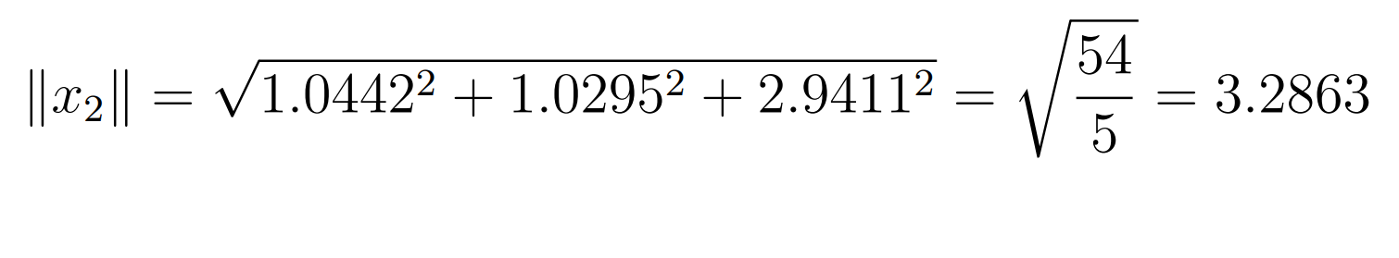
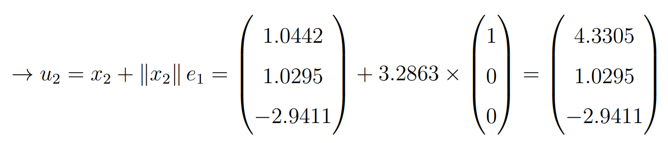
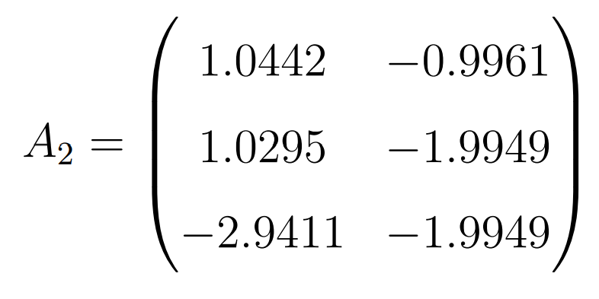
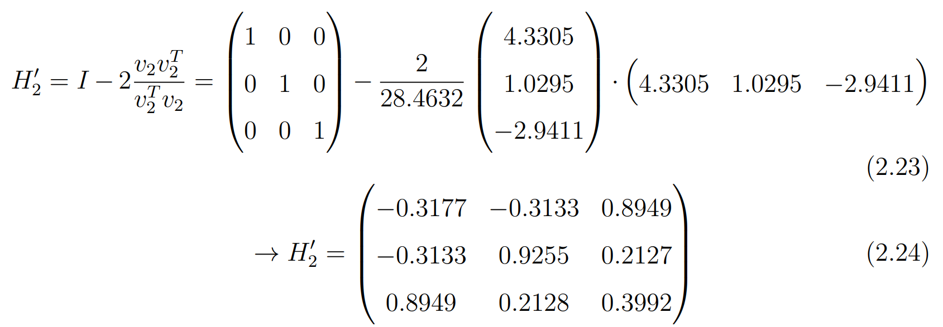
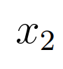
H2
Notes:
Taking the first column as vector x2, we use the same steps, and find u2, and H2

Slide 12
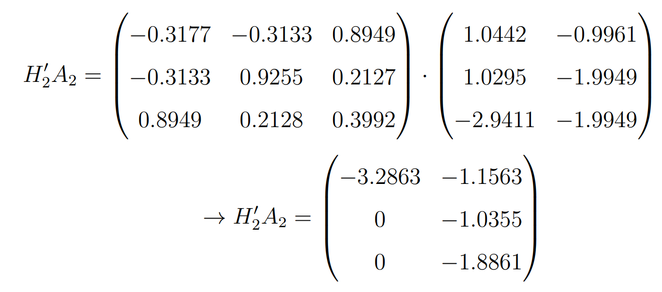
H3
Notes:
Once again we find H2A2, (CLICK) and remove the first row and column to get A3

Slide 13
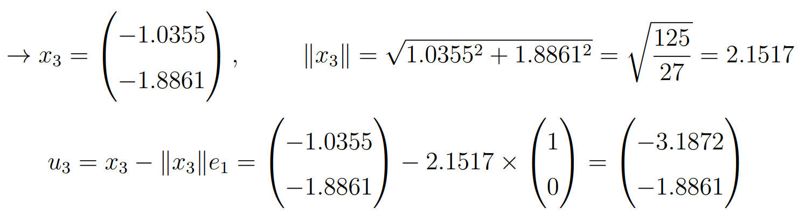
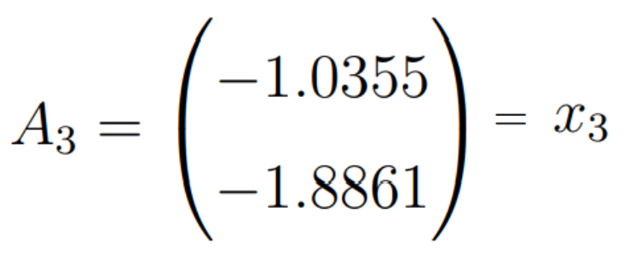
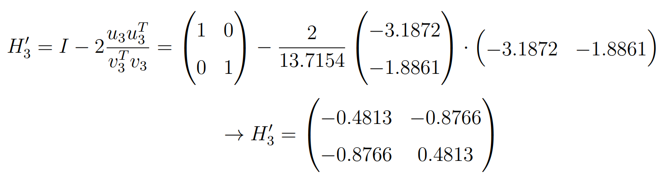
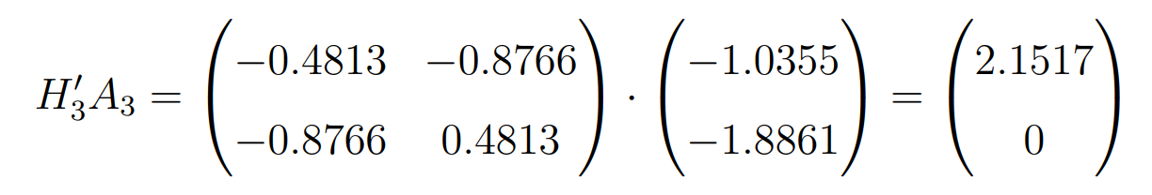
H3
Notes:
Same series of steps, x3 u3 h3. H3A3 is just one column, so we can’t go any further.

Slide 14
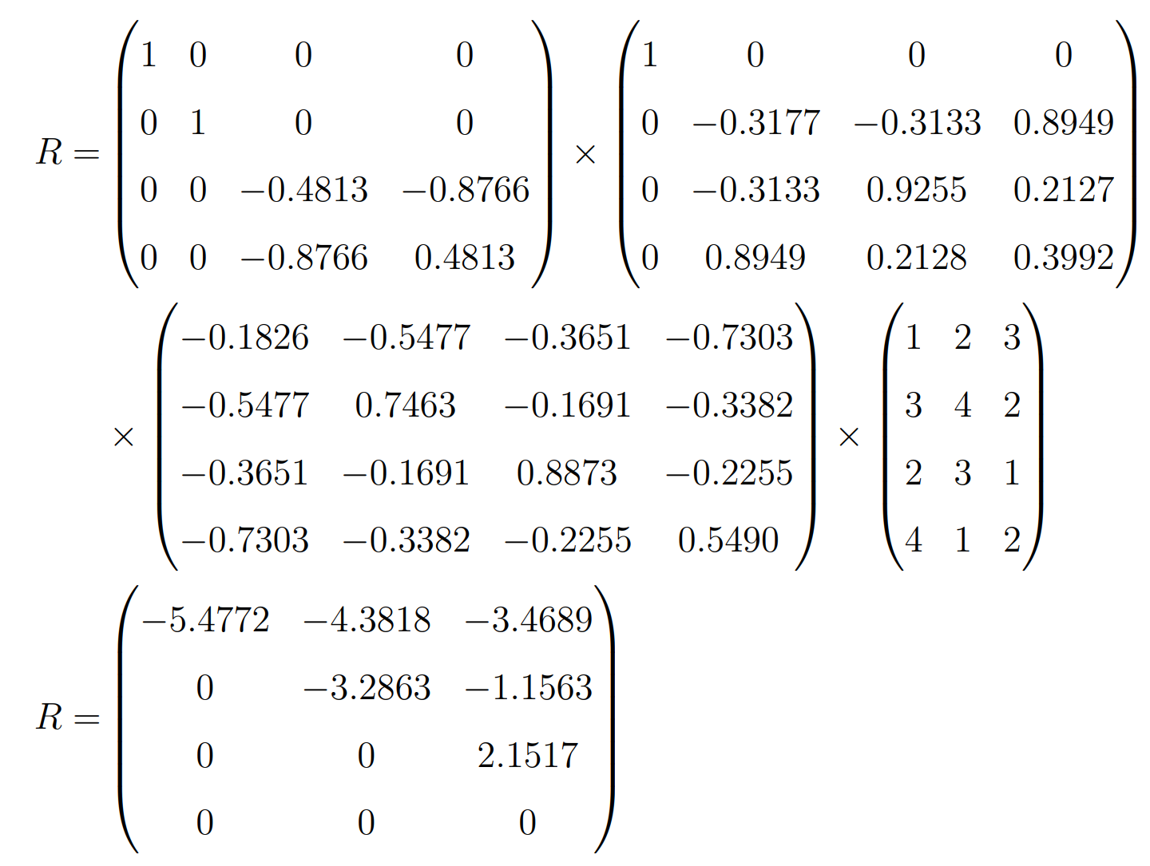
H3H2H1A = R
Notes:
Having found all the Hs, R is just H1A, then H2cross that, then H3cross that. Note we only considered the submatrices for calculating H2 and H3 earlier, here they are filled in in full.

Slide 15
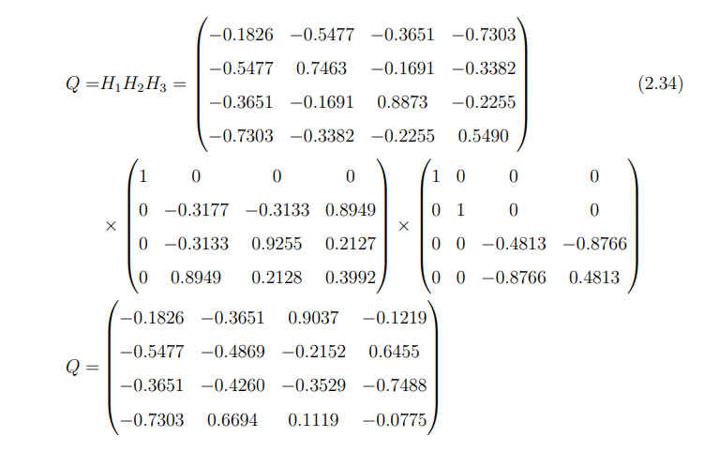
Q = H1H2H3
Notes:
Q is just the H matrices in opposite order. Next on, I’ll hand the time to Albert

Slide 16
Implementation
03.
Notes:
Hi everyone, my name is Albert and I will now present a real life application of using QR Decomposition to solve the least square approximation problem

Slide 17

Implementation
1
2
Code
Case Studies
Explanation of how our code works!
Featuring:
Case Studies
Factors of Happiness
Housing Prices in the US
Does alcohol make you happy?
Notes:
We will first start by explaining how our implementation code works and then we will move on to our case studies. However, due to time constraint, we will focus on our first case studies, factors of happiness

Slide 18
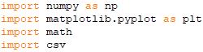
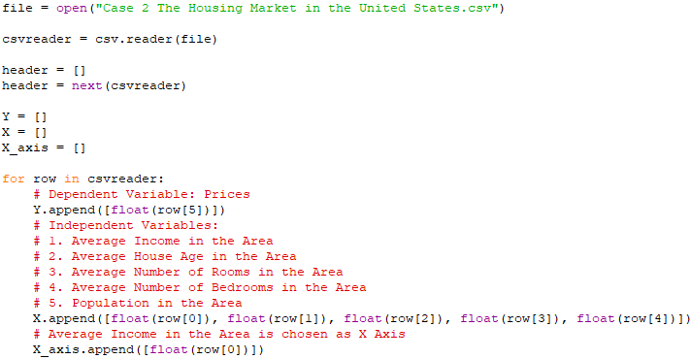
Implementation Code - Part 1
Import relevant libraries
Read in data from csv files and store them in the X and Y arrays
Y: Dependent variable
X: Independent variables
Notes:
Firstly, we start our implementation code by importing the relevant libraries
Secondly, we read in data from the csv files and store the Dependent Variable and Independent Variables into the Y and X arrays respectively.
We also store one of the independent variable as the X axis for graphing purposes.

Slide 19
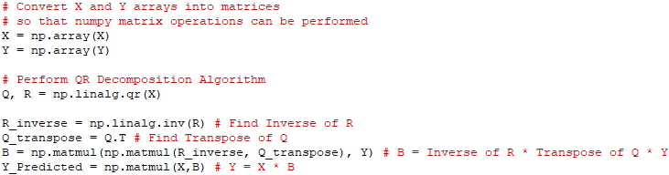
Implementation Code - Part 2
3. Linear Algebra operations using Numpy
Notes:
Thirdly, we perform linear algebra operations using Numpy in order to find the predicted Y values

Slide 20
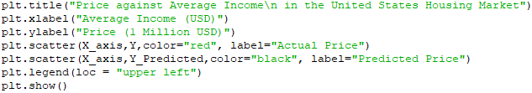
Implementation Code - Part 3
4. Data visualization using Pyplot
Notes:
Fourthly, we use pyplot to visualize the data

Slide 21
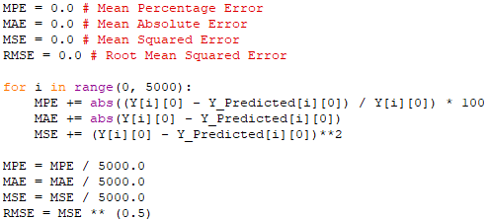
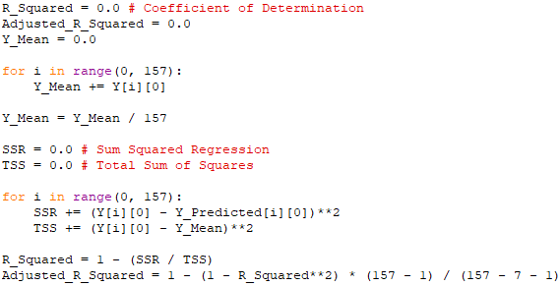
Implementation Code - Part 5
5. Evaluation of result
6. Redo with Single Independent Variable as comparison
Notes:
Fifthly, we measure Mean Percentage Error, Mean Absolute Error and Root Mean Squared Error and find the adjusted coefficient of Determination, or adjusted R^2, to analyze the accuracy of our model
Lastly, we redo this process with single independent variable for comparison purposes

Slide 22

Case Study 1: Factors of Happiness
Dependent Variable
Happiness Score of a Country
Independent Variables
Economy (GDP Per Capita relative to the United States in 2016) (X - Axis)
Family Score
Life Expectancy
Freedom
Government Trust
Community Generosity
Dystopia Residual
Data taken from World Happiness Report 2016
Notes:
Now, let us move on to our first case study, factors which influence happiness.
The dependent variable is the happiness score while the independent variables are as shown here. Note that GDP per Capita is arbitrarily chosen as the X-Axis in the graphing

Slide 23
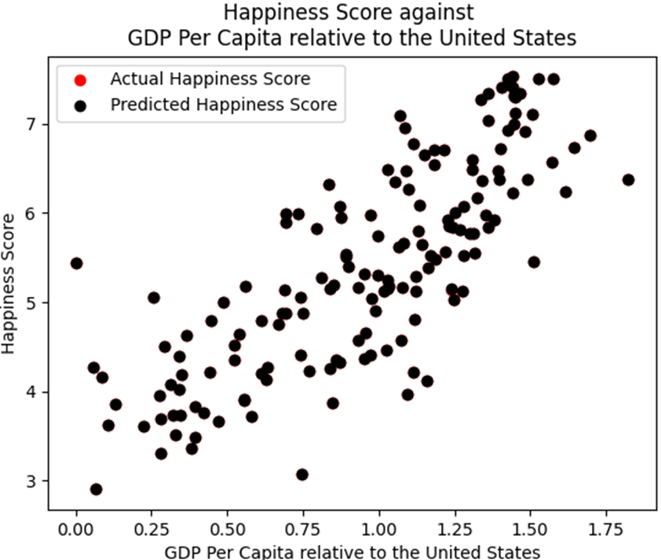
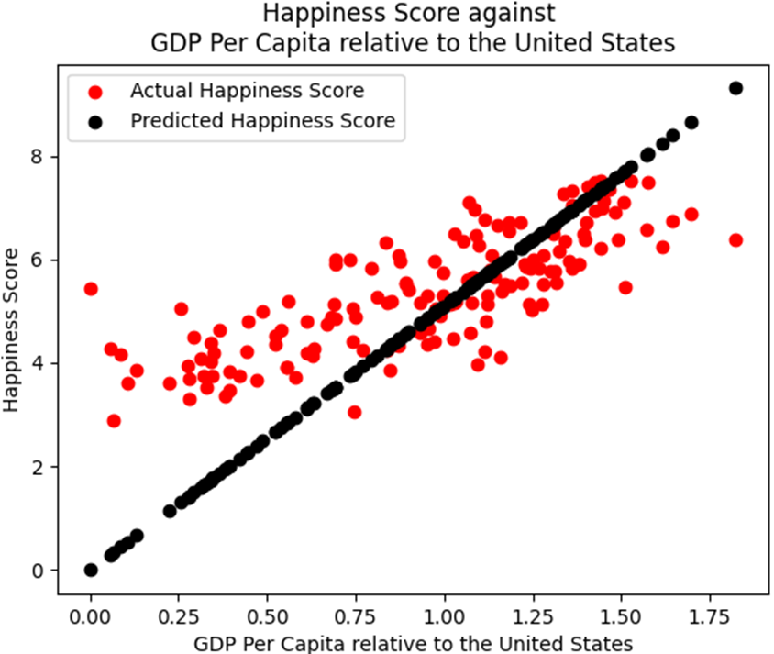
Key Insights
Multiple Independent Variables
Single Independent Variable
MPE | 0.004932398663796852%
MAE | 0.0002529862543912165
MSE | 8.658191814554322e-08
RMSE | 0.0002942480554660357
MPE | 23.895749714721507%
MAE | 1.1437203766602564
MSE | 2.1893494579509056
RMSE | 1.4796450445802554
Notes:
One key insight we learn from this case study is that taking into account multiple independent variables will allow us to make a more accurate models in general. This can be seen by the significantly better fit of the graphs and much lower error rates. For instance the mean percentage error using using multiple independent variables is 0.005 percent while that of using Single Independent Variables which is 23.9%.
This highlights the advantage of using QR Decomposition to solve least square problem in data modelling as compared to other methods such as single variable linear regression which only allows for one independent variable

Slide 24
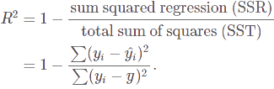
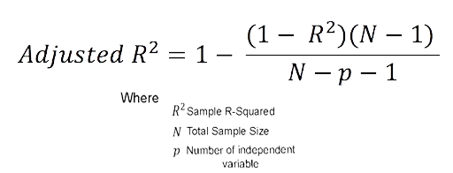
Key Insights
 | Multiple Independent Variables | Single Independent Variable
Adjusted R^2 | 0.99999986001332 | 0.47336662131759466
Notes:
However, we also find that adding a variable does not necessarily result in better fit. To check whether adding an independent variable result in better fit, adjusted R^2 can be used. If adding variable result in higher adjusted R^2, it means that adding that variable will result in better fit and vice versa. As can be seen here, adjusted R^2 value greatly increased from 0.47 to 0.99 upon adding the 6 relevant independent variables.

Slide 25
04.
Discussion

Slide 26
Advantages and Disadvantages of QR decomposition
2. Householder reflections:
Numerically stable because of the mechanism for producing zeros in the R matrix
Bandwidth heavy and not parallelizable as every reflection that produces new zero element will change the whole original matrix.
Notes:
Bandwidth refers to the amount of information that something, like a connection to the internet, can handle at a given time.
For the sake of time, I will only focus on ads and disads of QR decomposition algorithm we are using in the implementation section which is householder reflections.
The problem with this method is whenever we introduce a new zero element, reflection matrix will act on every entry of the original matrix to create a new matrix. Therefore, software will have to handle with heavy calculations. However, this method is still better than using Gram-Schmidt process.

Slide 27
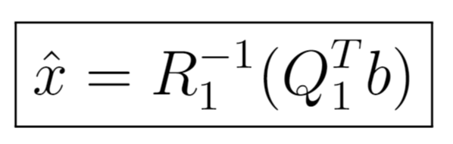
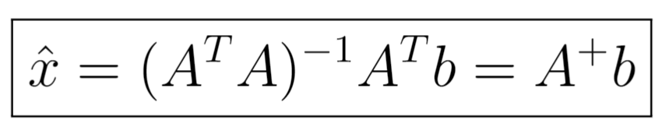
Why using QR decomposition?
By forming the product A^TA, we square the condition number of the problem matrix
⇾ Using QR decomposition makes a better least squares estimate than the Normal equation in terms of solution quality (more numerically stable)
Notes:
After doing some matrix calculation, these two solutions are identical and each expression of solution could be obtained from different methods but based on the same principle which is to find minimum of the norm of vector (Ax-b).
Soln with Q and R is proved to give a better least squares estimate in terms of solution quality OR in other words, the solution will be more numerically stable.

Slide 28
THANK YOU!

Slide 29
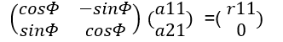
Gram Schmidt and Given rotations
Gram Schmidt: Using Orthogonal projection to find orthogonal matrix Q
Given rotations:
Introducing zeros in the matrix by using a series of Given rotations.
The basic transformation:
It is called a rotation because it is orthogonal, and its effect is to rotate a vector clockwise through the angle Φ

Slide 30

Case Study 2: Housing Prices
Dependent Variable
Housing Prices
Independent Variables
Average Income in the Area
Average House Age in the Area
Average Number of Rooms in the Area
Average Number of Bedrooms in the Area
Population in the Area
Data taken from US Survey 2019
Notes:
Our group implemented this algorithm in 3 case studies, namely factors of happiness, housing price in the united states and alcohol and happiness. Due to time constraint we will focus mainly on the first case study, followed by a brief mention of the third case study.
Our first case study is a data on factors which influence happiness. the Dependent variable is Happiness Score while the independent variables are GDP per capita, family score, life expectancy, freedom, government trust, community generosity and dystopia residual. GDP Per Capita is chosen as the X axis in the graphing.
We also re did this process using only a single independent variable, GDP per capita

Slide 31
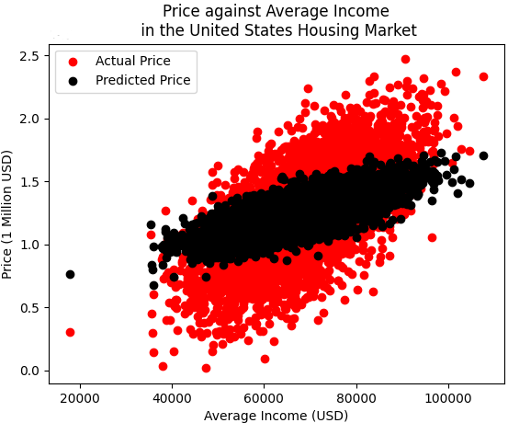
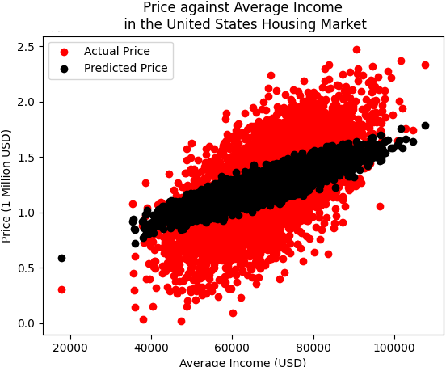
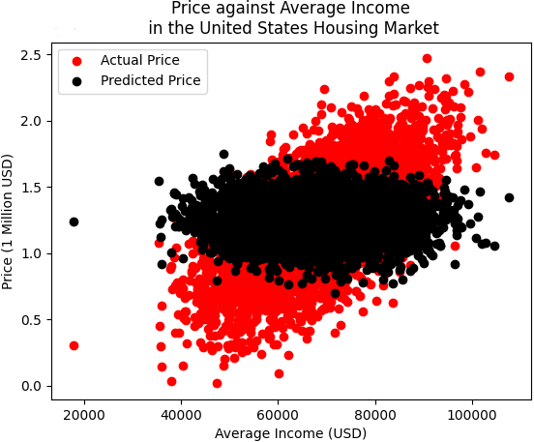
Key Insights
5 Independent Variables
4 Independent Variables
(without Population Size)
4 Independent Variables
(without Mean Income)
MPE | 21.421887173973253% | 22.619540352644073% | 23.87775083162673%
Adjusted R^2 | 0.28039252840049145 | 0.22273862850632908 | 0.15426473655188488
Notes:
In this case study, we wish to show that when we remove Population Size as an independent variable, there is lower fall in adjusted R^2 from 0.28 to 0.22 and lower increase in mean percentage error from 21.4 to 22.6%, compared to when we remove Mean Income where adjusted R^2 falls from 0.28 to 0.15 and MPE increased from 21.4 to 23.0. This shows how each independent variable has different correlation with dependent variable and how much it influences the dependent variable can be seen by the changes in adjusted R^2 value when we add or remove the dependent variable.
And now my friend hieu will elaborate on the discussion section of this presentation

Slide 32
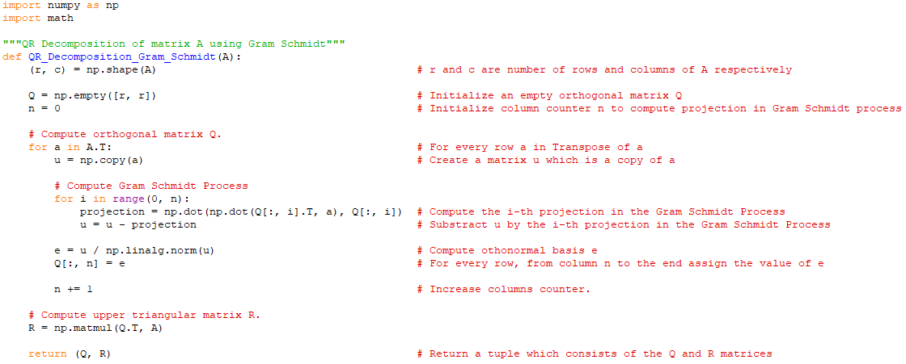
Notes:
In this case study, we wish to show that when we remove Population Size as an independent variable, there is lower fall in adjusted R^2 from 0.28 to 0.22 and lower increase in mean percentage error from 21.4 to 22.6%, compared to when we remove Mean Income where adjusted R^2 falls from 0.28 to 0.15 and MPE increased from 21.4 to 23.0. This shows how each independent variable has different correlation with dependent variable and how much it influences the dependent variable can be seen by the changes in adjusted R^2 value when we add or remove the dependent variable.
And now my friend hieu will elaborate on the discussion section of this presentation

Slide 33
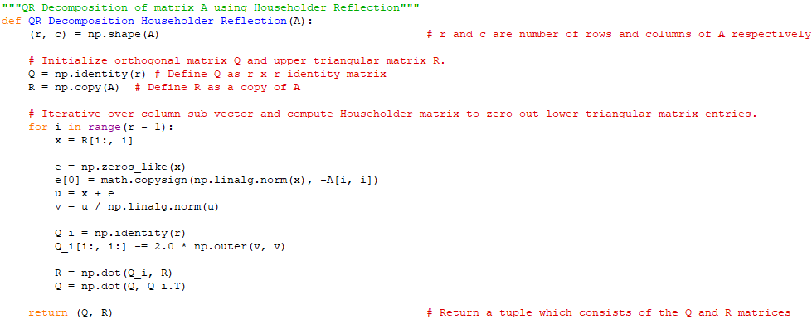

Slide 34
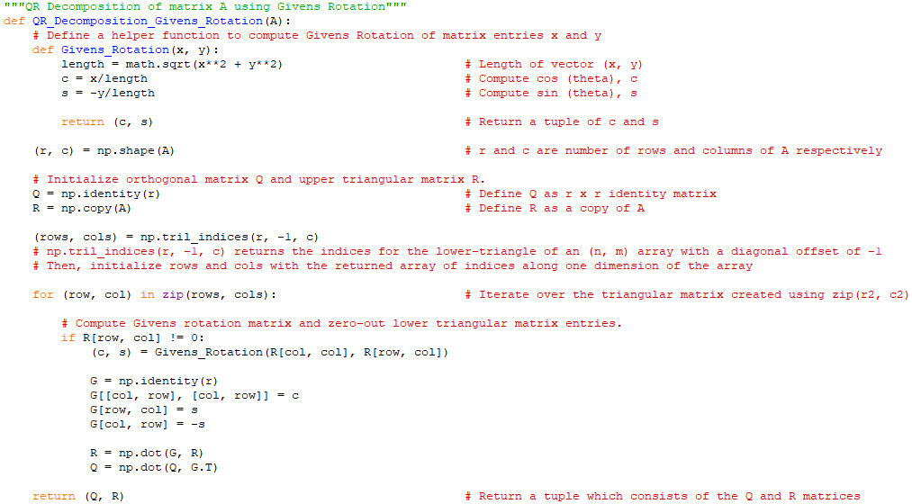

Slide 35
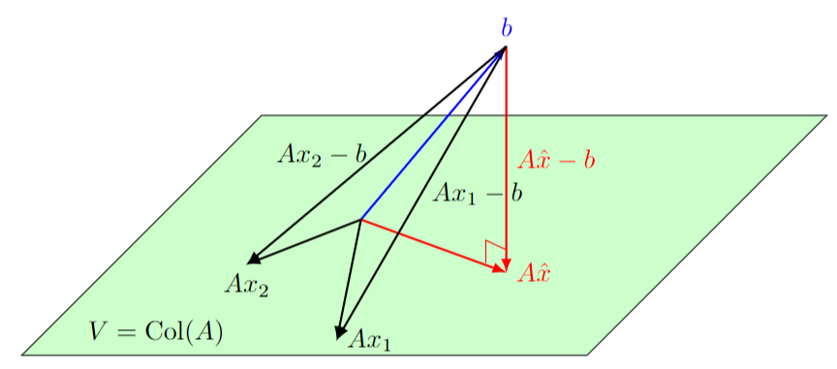
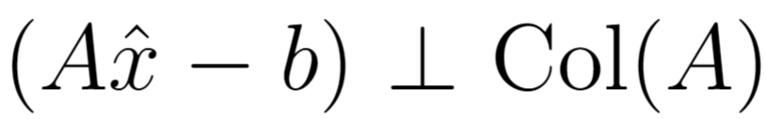
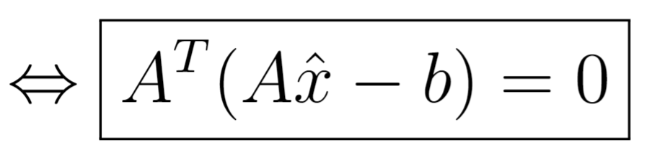
Geometric interpretation of Least Squares solution

Slide 36
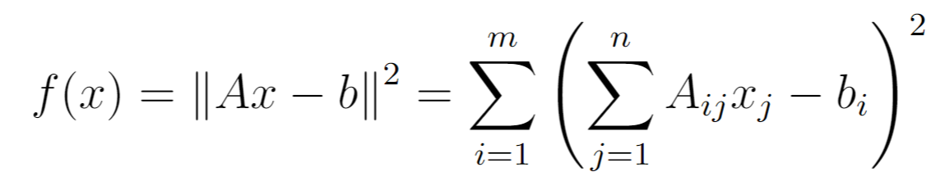
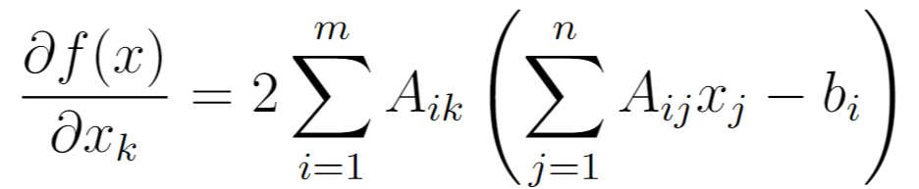
Derivation from calculus
Notes:
f(x) is a squared norm of vector (Ax-b).

Slide 37
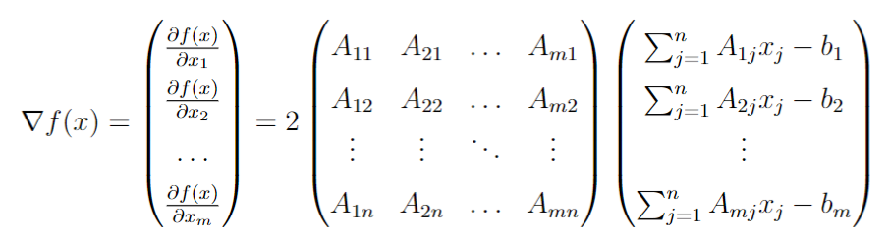
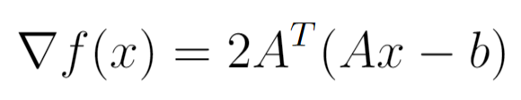
Derivation from calculus
0

Slide 38
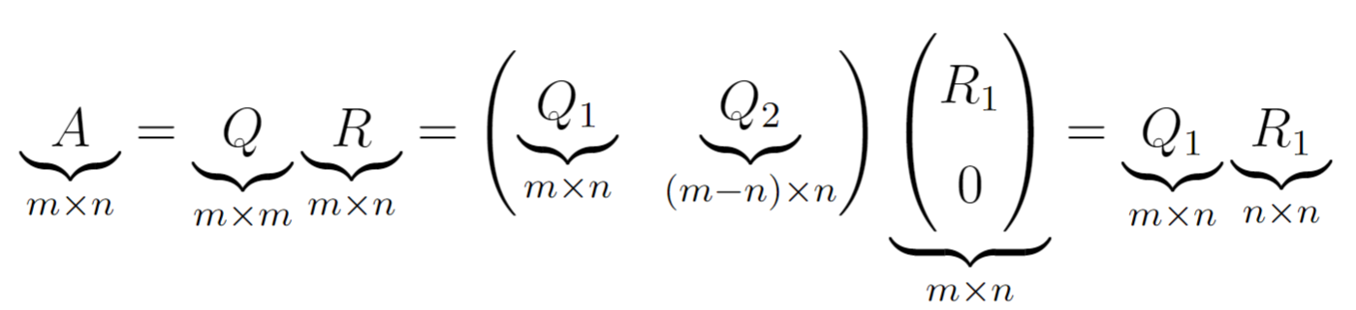
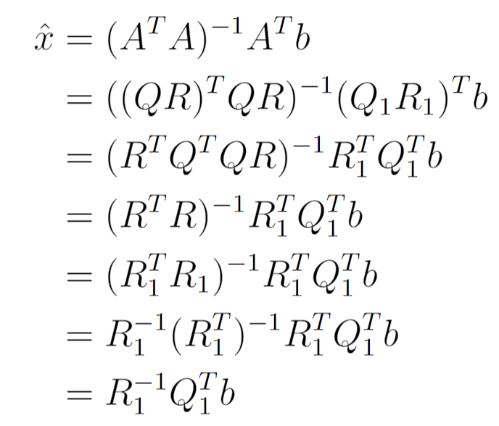
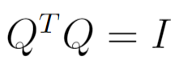
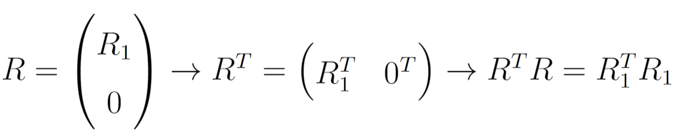
Least squares solution
Notes:
In real life, data are random so the probability that the very long matrix A is invertible is very high, hence the least squares solution in real life is unique most of the time

Slide 39
Advantages and Disadvantages of QR decomposition
Gram-Schmidt process:
Numerically unstable
Applications of the projections has an appealing geometric analogy to orthogonalisation, but orthogonalisation itself is prone to numerical error.
ease of implementation in case software does not have pre-built linear algebra library.

Slide 40
Advantages and Disadvantages of QR decomposition
3. Givens Rotation:
the ordering of the rows required to fully exploit the algorithm is not trivial to determine -> problem related to implementation.
However, every time it introduces a new zero element, only two rows, one row with the element to be zeroed and the row above will be affected.
Hence, this rotation algorithm is more bandwidth efficient and parallelizable than the Householder reflection methods

Slide 41
Consider an estimation problem where you're trying to find the vector x after it has passed through a mixing matrix A and has white noise added:
y=Ax+ey=Ax+e
If the elements of x are from a finite alphabet then you can proceed as follows. First determine the QR decomposition of A, then multiply the observed vector y by the transpose of Q:
QTy=Rx+QTeQTy=Rx+Qte
Since Q is a unitary matrix it does not change the covariance of the noise, that is, if
E[eeT]=σ2IE[eeT]=σ2I
then
E[QTeeTQ]=σ2IE[QTeeTQ]=σ2I
This is analogous to saying that the QR decomposition is numerically stable.
Once this has been found the elements of x can be calculated by backsubstitution, but before back-substituting, each element of x can be 'rounded' to the nearest point in the finite alphabet.

